Slide 1
Parallelizing Dijkstra’s Algorithm
Cain Wock
Matthew Hill
Cody Ponder
Deidre Brennan

Slide 2
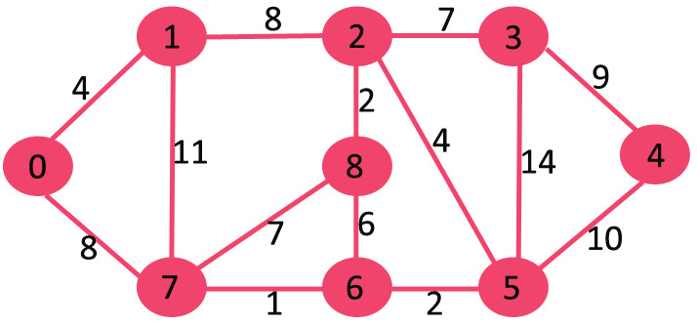
What is dijkstra’s Algorithm?
Dijkstras algorithm is for finding the shortest paths between nodes in a graph

Slide 3
How it works
Most implementations pick a “source” node and calculate the distance to other nodes.
By picking an unvisited vertex with the lowest distance, the algorithm calculates the distance through it to each unvisited neighbor and then updates the neighbors distance if it is smaller than the previous known distance.
Once a node has been visited, it will be marked so it cannot be visited again.

Slide 4
VISUAL AID
In this diagram, the root node is 1 and the destination node is 5
When the distance to a node has not yet been calculated, it is seen as infinite

Slide 5
Visual Aid
Node 2 is visited first because it has the shortest distance of 7
The distances of nodes 3 and 6 are then determined.

Slide 6
Visual Aid
Node 2 will be chosen as the new Base because it has the shortest distance
Node one will be marked so it can no longer be visited
9
1
2
7

